Slide 1

SCHOOL OF ELECTRONICS ENGINEERING
KALINGA INSTITUTE OF INDUSTRIAL TECHNOLOGY
Deemed to be University, Bhubaneswar - 751024
Minor Project
REDUCTION OF LARGE SCALE INDUSTRIAL PAPER PRODUCTION USING MACHINE LEARNING
Supervisor: Prof.
(2005495) | Mr. Agrasth Naman
(2005503) | Mr. Ansh Kapoor
(20051634) | Mr. Aditya Nigam
(20051637) | Mr. Ayush Anand

Slide 2
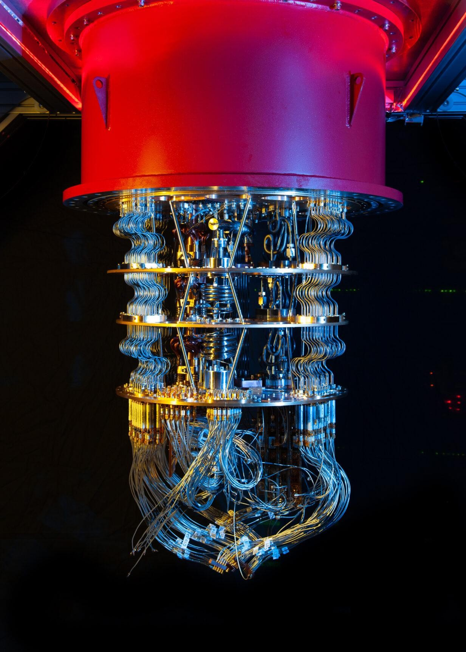
“A machine learning based SOLUTION to counter the negative impact of large-scale industrial paper production on NATURE and the economy.”

Slide 3
Introduction
During the COVID-19 pandemic students and working professionals all over the world transitioned to electronic media that changed the global work culture.
The future is digital and needs integration and a hybridized system to evolve.
Therefore, we have decided to develop a machine learning based solution to tackle the impact of:
Large-scale industrial paper production on environment.
Institutional & courier charges for the distribution of study materials/textbooks per semester in an academic year.

Slide 4
Literature Review
Author | Title | Source | Findings
Chao-Ying Joanne Peng, Kuk Lida Lee, Gary M. Ingersoll (2002) | An Introduction to Logistic Regression Analysis and Reporting | Indiana University Bloomington | Logistic regression is a powerful analytical technique for use when the outcome variable is dichotomous.
Adriana Erthal Abdenur (2020) | How Can Artificial Intelligence Help Curb Deforestation in the Amazon? | The Global Observatory | Tracking deforestation using satellite imagery analysis.
L . Maria Subashini (2015) | Review on Biological Treatment processes of Pulp and Paper Industry Waste Water | IJIRSET | The pulp and paper industrial waste waters are a major environmental concern.

Slide 5

Methodology
1
4
Deﬁning the problem statement
Exploratory Data Analysis (EDA)
2
5
Acquiring the dataset
Splitting the dataset
3
6
Data Preprocessing
Training the model

Slide 6
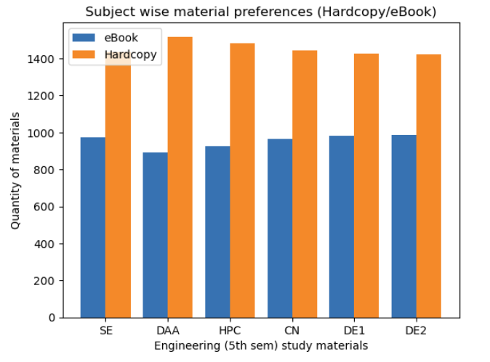
Exploratory Data Analysis
Observations:
More no. of students have chosen hardcopy in the subject Design and Analysis of Algorithms (DAA).
There is a sharp similarity in the subjects of Department Elective 1 (DE-1) and Department Elective 2(DE-2) as both these subjects show an almost identical trend.

Slide 7
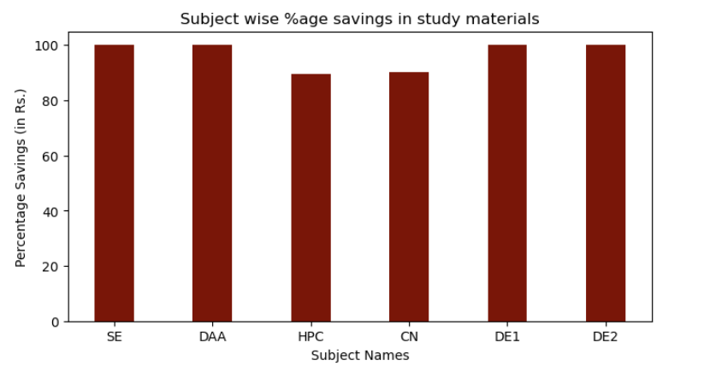
Exploratory Data Analysis
Observations:
It can be seen that 100% of the ‘total amount’ of Software Engineering (SE), Design and Analysis of Algorithms (DAA) and Department Elective-2 (DE-2) is saved.
The subject of High Performance Computing (HPC) stands lowest with around 89.6% savings.

Slide 8
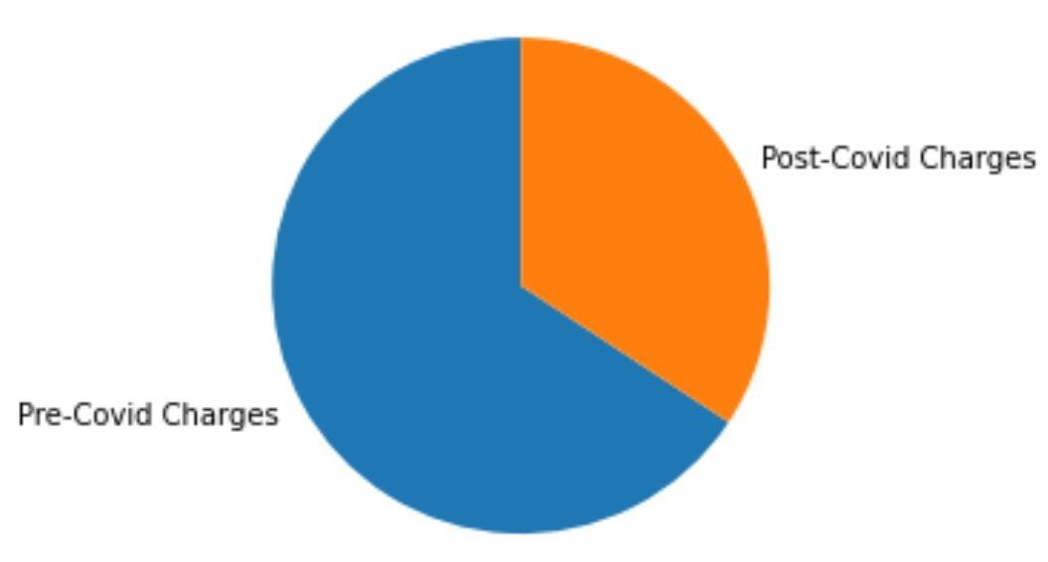
Exploratory Data Analysis
Observations:
It is evident from the pie chart that the total weight, transportation and courier charges of study materials have been reduced to about one-third after the Covid-19 pandemic.
Fig: Pie chart representing the courier charge estimates

Slide 9
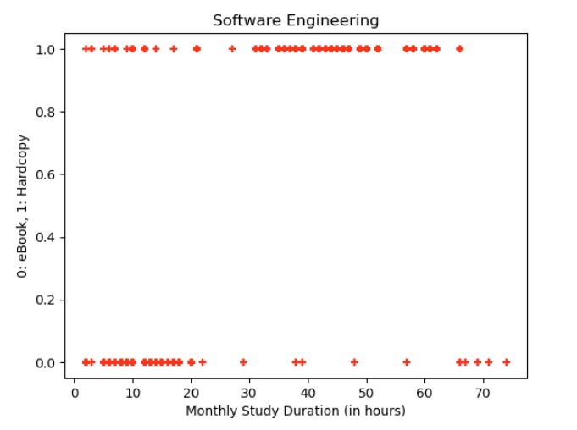
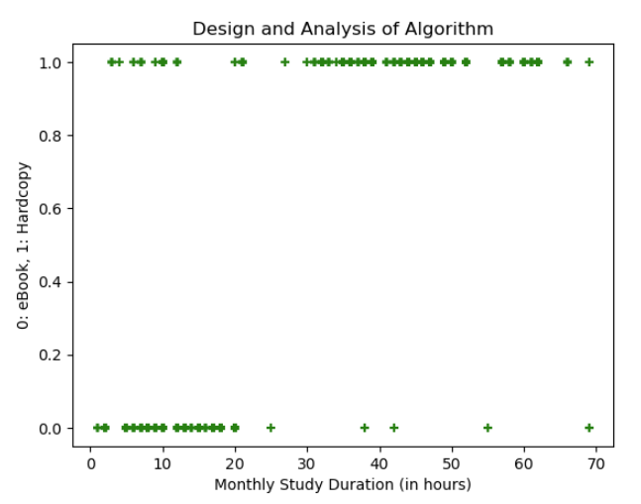
Scatter Plots

Slide 10
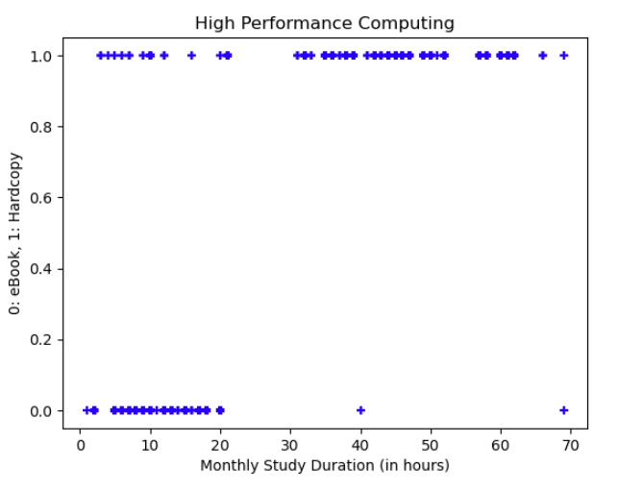
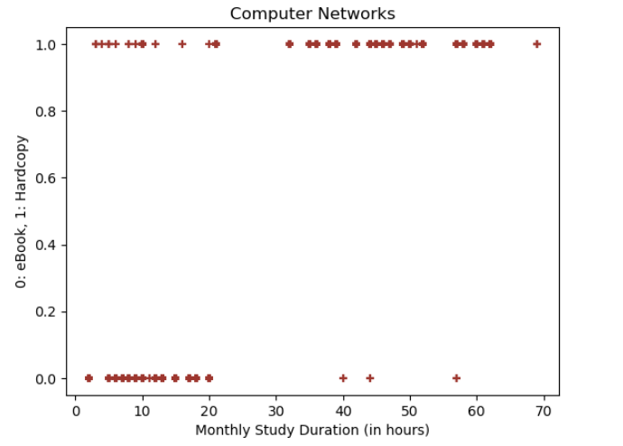
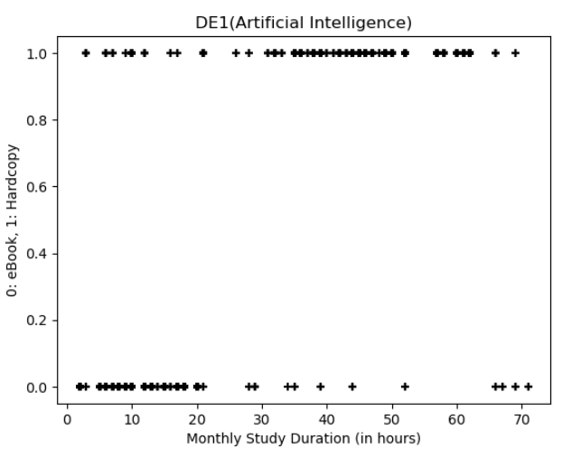
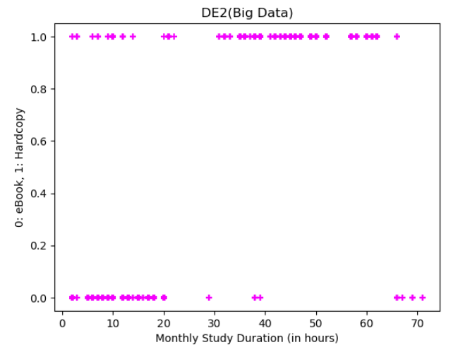

Slide 11
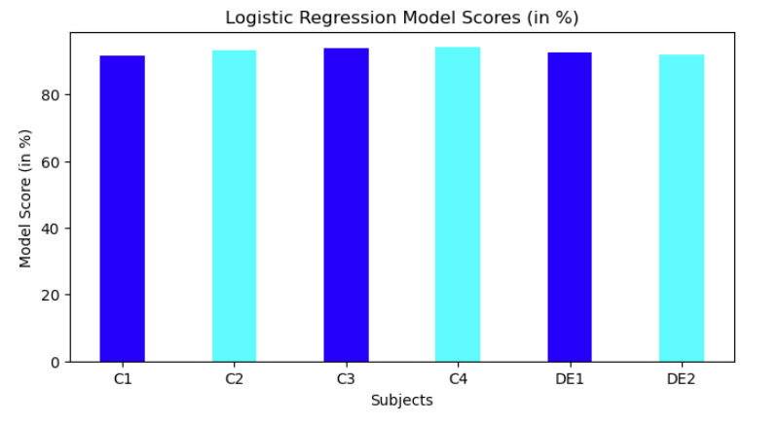
Subjectwise Model Scores
Observations:
It can be inferred that the model score for CN stands highest with 94.01% and HPC holds the second place at 93.68%.
Software Engineering stands lowest with a regression model score of 91.69%.

Slide 12
Advantages
IT industry once predicted that its emergence is to make paperless oﬃces but its amazing to ﬁnd that about 95% of oﬃce work across the world is still done on paper.
Reduction in deforestation.
Portability and better memory management.
Decrease in the amount of industrial toxins used to create pulp and bleach.
Boost in the eﬃciency of water treatment.
Promotes the concept of three R’s (Reduce, Reuse & Recycle)
42% of all global wood harvest is used to make paper. Is it really worth it to cut down our life saving trees for this product?
Also the bleaching reagents without proper treatment that get released into river bodies prove to be graveyard for hydrological ecology.
According to a survey, an average tree gets converted in to 12000 A4 sheets. As per our calculations, we require almost 300 trees to run an engineering semester (6 month duration) and a tree requires a minimum of 3 years to grow and become mature.

Slide 13
Conclusion
This customized mechanism will help a learner optimize his study routine by reading books from a combination of:
Electronic devices (laptops/smartphones/tablets) and/or
Hardcopy format (conventional method).
It was also evident that a hybridized workﬂow like this can help the department save millions of rupees annually.
There are several other advantages of adopting this methodology which were brieﬂy discussed in the previous slide.

Slide 14
References
Chao-Ying Joanne Peng, Kuk Lida Lee, Gary M. Ingersoll (2002). “An Introduction to Logistic Regression Analysis and Reporting” Indiana University-Bloomington.
Adriana Erthal Abdenur (2020). “How Can Artiﬁcial Intelligence Help Curb Deforestation in the Amazon?” The Global Observatory.
L . Maria Subashini (2015). “Review on Biological Treatment processes of Pulp and Paper Industry Waste Water” IJIRSET.

Slide 15

Thank you!
Connect with us at:
Agrasth Naman 2005495@kiit.ac.in
Ansh Kapoor 2005503@kiit.ac.in
Aditya Nigam 20051634@kiit.ac.in
Ayush Anand 20051637@kiit.ac.in

